Slide 1
5 KEYS TO COMBAT ANXIETY
ETHOS TIME
⏰

Slide 2
CHECK OUT TODAY’S VIDEO…
TAKE THE #ETHOSCHALLENGE ON SOCIAL MEDIA
ETHOS TIME
⏰

Slide 3
Why does a crisis makes us feel anxious?
TAKE THE #ETHOSCHALLENGE ON SOCIAL MEDIA
ETHOS TIME
⏰

Slide 4
5 keys to combat anxiety
1
4
Accept
Pause
2
5
Engage
Learn
3
Move
TAKE THE #ETHOSCHALLENGE ON SOCIAL MEDIA
ETHOS TIME
⏰
Notes:
This with the places to get help from the blog post could be a bookmark handout.

Slide 5
1
Accept When it is a strange and difficult time, it is okay to give yourself permission to grieve and feel sad about how different life looks and that there are things that you can’t do any more. Grieving doesn’t mean staying in a place of sadness but dealing with your emotions until you finally come to a place of acceptance.
2
Engage Look for ways to have face to face time with others. Try using free video apps if you can’t meet in person. Seeing someone’s face and hearing their voice always leads to a greater sense of connection than just texting to chat or posting images online.
3
Move Try doing exercise or help with practical stuff around the house. Exercise gets rid of adrenaline and causes the release of endorphins which is a happy hormone! Helping and engaging with something practical for someone else can take your mind off anxious thoughts and leave you with a sense of achievement.
TAKE THE #ETHOSCHALLENGE ON SOCIAL MEDIA
ETHOS TIME
⏰

Slide 6
4
Pause Take 10-15 minutes a day just being quiet and becoming aware of how your body is feeling. This could look practising mindfulness, having some quiet time or taking deep breaths. Some people pray as a way of connecting with themselves and their spirituality. Have an attitude of gratitude! Taking time out means being thankful for the good things that you do still have in your life.
5
Learn Keeping your mind active through studying and learning is good for your mental health. As well as your studies for school, you can learn about topics for fun as well! Have you always wanted to learn sign language or how to bake a cake? Temporary distraction is a great technique provided it doesn’t become about long term covering up what needs to be dealt with on the inside.
TAKE THE #ETHOSCHALLENGE ON SOCIAL MEDIA
ETHOS TIME
⏰

Slide 7
Questions for reflection
What has coronavirus taken from you?
It’s okay to be sad and grieve for the things you’ve lost, and that life looks different.
What has coronavirus not taken from you?
There are lots of things that you still have and can be thankful for e.g. family, friends, pets, food, a home.
What opportunities has coronavirus given you?
Lots of us have more time and other opportunities. How can you use this time wisely? What new things could you learn? How could you be kind?
TAKE THE #ETHOSCHALLENGE ON SOCIAL MEDIA
ETHOS TIME
⏰

Slide 8
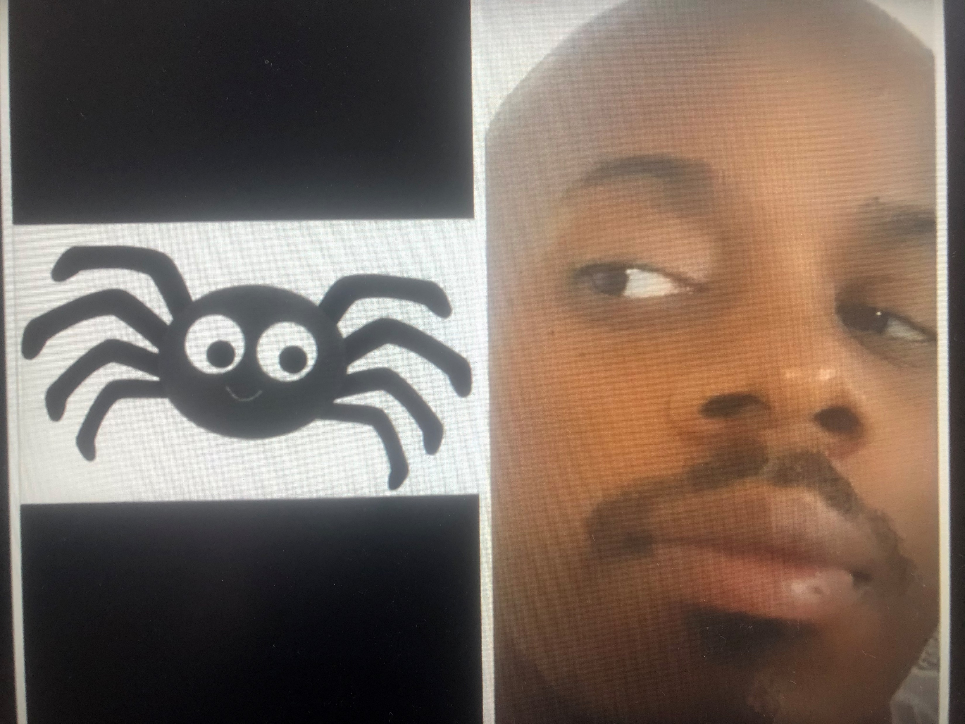
TAKE THE #ETHOSCHALLENGE
ON SOCIAL MEDIA
Make a MEME on social media of something you used to be afraid of in the past, but you have now overcome that fear for the future.
FOR EXAMPLE “I used to be scared of Spiders… but I am alright now!”
Use the hashtag #ethoschallenge to share with others.
Follow us on Instagram: @GracefoundationUK
TAKE THE #ETHOSCHALLENGE ON SOCIAL MEDIA
ETHOS TIME
⏰

