Slide 1
Responding
to Racism
ETHOS TIME
⏰

Slide 2
Racism is the belief that one race is superior or inferior to another. It is rooted in the idea that your physical and biological characteristics determine what kind of person you are - for better or worse.
ETHOS TIME
⏰

Slide 3
Racism and racist bullying can include:
being called racist names or being sent insulting messages or threats
having your belongings damaged or having to see racist graffiti
personal attacks, including violence or assault
being left out, treated differently or excluded
people making assumptions about you because of your colour, race or culture
being made to feel like you have to change how you look
racist jokes, including jokes about your colour, nationality race or culture.
“Racism can affect anyone. It can make you feel like you’re not important or don’t fit in. You might feel upset, depressed or angry. You can be affected by it even when it’s not aimed at you, like if you hear someone discriminating against someone’s culture.”
SOURCE: https://www.childline.org.uk/
RACISM IS NOT JUST ABOUT INDIVIDUAL HARM… IT CAN ALSO RUN DEEPER IN SOCIETY IN THE WAY THE SYSTEM IS NOT SET UP TO BE EQUAL FOR EVERYONE.
ETHOS TIME
⏰

Slide 4
CLICK TO WATCH THIS POWERFUL VIDEO:
Where do I even begin? A POEM
In this video Gina shares a poem about her heartfelt response and frustration about racism and the change we need to see for the future.
What do you think the key message is in this video and what is your response to it?
ETHOS TIME
⏰

Slide 5
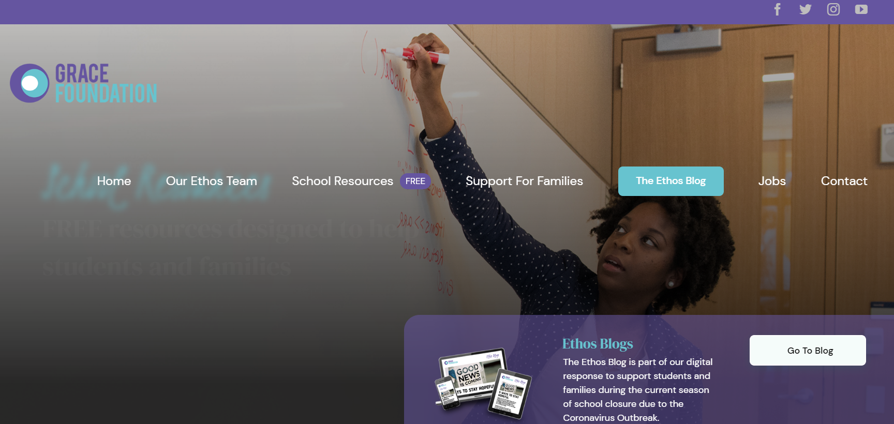
1
Listening How could you pause and listen to someone’s story that is different than your own?
2
Learning How can you commit to learn about the history of injustice and racism that exists in our society?
TAKE 5 MINS TO READ THE LATEST ETHOS BLOG AND THEN THINK ABOUT YOUR RESPONSE TO THE 3 POINTS SHARED HERE
LINK:
https://www.grace-foundation.org.uk/racism/
3
Leading What kind of creative way you can share your own story or use creativity to help stand up for justice? Think about art, poetry and media.
ETHOS TIME
⏰

Slide 6
Further Reading & Resources:
Learn more about what to do if you have experienced racist bullying including having someone to talk to:
https://www.childline.org.uk/info-advice/bullying-abuse-safety/crime-law/racism-racial-bullying/
There are some resources that might help you start educating yourself on the BBC Bitesize website including hearing experiences of racism. https://www.bbc.co.uk/bitesize/clips/zqvnvcw
The Black History Month website is a fantastic resource all year round and has a News section highlighting up to date news, views and opinions.
https://www.blackhistorymonth.org.uk/section/news-views/
Need to talk?
ETHOS TIME
⏰

