Slide 1
My Family & Caring Relationships Tree
ETHOS TIME
#RSEDay
⏰

Slide 3
CLICK TO WATCH THIS WEEK’S VIDEO:
In our Latest Ethos Video Husnaa from Grace Foundation shares some of the Secret Ingredients to stronger family relationships…
What do you think the key message is in this video and what is your response to it?
ETHOS TIME
⏰

Slide 4
"
“A group of people who are related to each other.”
“Two or more people who share goals and values, have long-term commitments to one another and reside usually in the same dwelling."
What is family…??
For some, the true meaning of family means a group of people related by blood or ancestry. To others, it has nothing to do with genes and everything to do with love, compassion, and support. The definition of the word family can mean many things.
ETHOS TIME
#RSEDay
⏰

Slide 5
1
CREATE YOUR CARING TREE! copy one of the diagrams on the next slide on a large piece of paper and colour in, or use the online slide version.
2
ADD PHOTOS Add titles and photos for your family & caring relationships. You could include parents, grandparents, carers, foster carers, youth workers, religious leaders, neighbours, teachers and friends.
3
DISPLAY Once finished pin up the drawing in your home as a celebration of the uniqueness of your caring tree & supportive relationships! #Ethos Challenge = think about how you can say thank you to one member of your support network this week.
ETHOS TIME
#RSEDay
⏰

Slide 6
CARING Tree
Grandparent
Grandparent
Grandparent
Grandparent
Neighbour
Foster carer
Aunt
Aunt
Parent/step parent
Parent/ step-parent
friend
church leader/ teacher
Brother/ step-brother
youth worker
sister
ME!!!
best friend

Slide 7
CARING Tree2

Slide 8
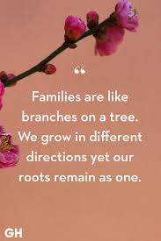
KS4: How can family and caring relationships become strained during lockdown?
What are the best strategies we can use to improve our relationships?
KS3: What does this mean and do you agree or disagree with this statement?
ETHOS TIME
#RSEDay
⏰

Slide 9
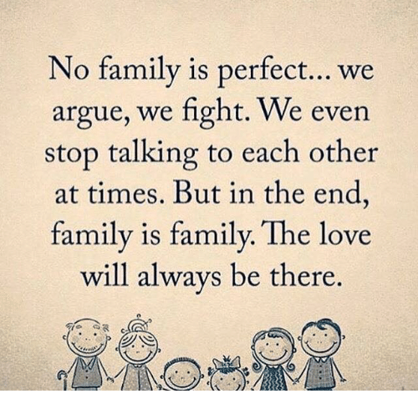
Note down 3 practical examples to show gratitude to your family & people who care about you.
#ETHOSCHALLENGE
ETHOS TIME
#RSEDay
⏰

Slide 10
Matthew 7:12 The Message (MSG)
“Here is a simple, rule-of-thumb guide for behavior: Ask yourself what you want people to do for you, then grab the initiative and do it for them.
ETHOS TIME
⏰

