Slide 1


How to Tackle Stress
ETHOS TIME
⏰

Slide 2

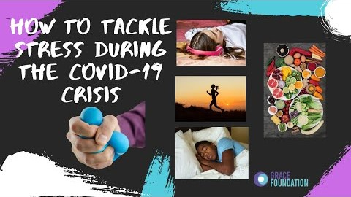
CLICK HERE TO WATCH THIS HELPFUL VIDEO
ETHOS TIME
⏰

Slide 3

What can you try this week?
EAT HEALTHILY
There is a growing amount of evidence that food can affect our mood so try and eat as healthily as possible.
EXERCISE
This is such an effective way of relieving stress, even if you go for one short walk a day outside or take a trip to the park.
TAKE TIME OUT TO RELAX
Strike the balance between your responsibilities and priorities; making sure you prioritise self-care! This will often help you find a simple solution to the problem you’re feeling so stressed about.
TOP TIPS
ETHOS TIME
⏰

Slide 4

What can you try this week?
GET SOME SLEEP
Try and have a healthy sleep pattern! Perhaps you can journal your thoughts before you sleep to help your mind to relax and not run in overdrive.
DON’T BE TOO HARD ON YOURSELF!
Try and keep things in perspective, be kind to yourself and look at the positives in life.
Remember in all of this, you are not alone! A recent survey showed that 74% of people felt stressed and overwhelmed at some point over the last year. We can get through this together!
TOP TIPS
ETHOS TIME
⏰

Slide 5
YOUR PRO TASK:
Go through the TIPS and make a plan for which ONE OR TWO you will try this week. What exactly can you do? What is the priority for you right now?
Review at the end of the week and try another tip next week
Keep a record of what makes the most difference for you!
REPEAT AND BECOME A PRO!
ETHOS TIME
⏰

Slide 6


Further Reading & Resources:
SAMARITANS are a brilliant charity if you’re feel like you need to chat to someone urgently or need confidential support. Call a member of their team: 116 123 (free 24-hour helpline) or visit their website.
MIND is a great organisation with lots of advice and tips. You can chat someone in their team: 0300 123 3393 or visit their website.
Need to talk?
ETHOS TIME
⏰

