Slide 1



Notes:
Welcome everyone and introduce the training about the Tranquility Abundant Life course - created by Reality Youth Project that we have use of

Slide 2
Timetable
Session 1 - Understanding Anxiety
Session 2 - Tranquility
Break

Slide 3
Session 1 - Understanding Anxiety
Our present reality
What is anxiety?
What are the signs and symptoms of anxiety?
Maddie’s story
How can we help young people manage their anxiety?
Helpful websites

Slide 4
Session 2 - Tranquility
What is ‘Tranquility’?
How prepare, deliver and follow up a ‘Tranquility’ course
A week by week look at course materials
Accessing materials
Franchise and licence agreement
Notes:
End this by saying that if anyone needs a moment or would like to step outside then that is absolutely fine

Slide 5

SESSION 1 - UNDERSTANDING ANXIETY

Slide 6
Our present reality
The experts tell us:
Anxiety disorders are the most common mental health disorder in children and young people
1 in 3 young people will have an anxiety disorder by the age of 18
Girls are more likely to suffer with anxiety but not by much
In a recent survey for Young Minds:
80% of respondents agreed that the coronavirus pandemic had made their mental health worse. 41% said it had made their mental health “much worse”. This was often related to increased feelings of anxiety, isolation, a loss of coping mechanisms or a loss of motivation
Notes:
The experts tell us… everyone is effected my anxiety at some point in their lives.

Slide 7
What is anxiety?
apprehensive uneasiness or nervousness usually over an impending or anticipated ill : a state of being anxious
medical : an abnormal and overwhelming sense of apprehension and fear often marked by physical signs (such as tension, sweating, and increased pulse rate), by doubt concerning the reality and nature of the threat, and by self-doubt about one's capacity to cope with it
(Merriam Webster)
Notes:
How would people describe anxiety?

Slide 8

Notes:
Fight Flight Freeze
Often when faced with anxiety we do one of three things, fight, flight or freeze - lets watch this
https://www.youtube.com/watch?v=r3m-h-GV-n8

Slide 9
What is anxiety?
Type | Definition | Percentage %
Panic disorder | A condition caused by frightening or distressing events | 5.0 %
Agoraphobia | A condition that usually involves unwanted thoughts or urges, and repetitive behaviours | 7.6%
Generalised anxiety disorder (GAD) | Several phobias related to situations such as leaving home, being in crowds or travelling alone | 9.1%
Obsessive compulsive disorder | A condition where you have recurring, regular panic attacks | 2.2%
Post-traumatic stress disorder | An extreme or irrational fear of something, like an animal or a place | 19.3%
Phobias | A long-term condition that can make you feel anxious about a wide range of situations and issues, rather than one specific event | 2.3%
Notes:
Matching game

Slide 10
What is anxiety? (The answers)
Type | Definition | Percentage %
Panic disorder | A condition where you have recurring, regular panic attacks | 2.3%
Agoraphobia | Several phobias related to situations such as leaving home, being in crowds or travelling alone | 9.1%
Generalised anxiety disorder (GAD) | A long-term condition that can make you feel anxious about a wide range of situations and issues, rather than one specific event | 2.2%
Obsessive compulsive disorder | A condition that usually involves unwanted thoughts or urges, and repetitive behaviours | 7.6
Post-traumatic stress disorder | A condition caused by frightening or distressing events | 5.0 %
Phobias | An extreme or irrational fear of something, like an animal or a place | 19.3%

Slide 11

Signs and symptoms of anxiety
feeling nervous, on edge, or panicky all the time
feeling overwhelmed or full of dread
feeling out of control
having trouble sleeping
low appetite
finding it difficult to
concentrate
feeling tired and grumpy
Notes:
In groups write down a few or shout out

Slide 12

Signs and symptoms of anxiety
having a dry mouth
heart beating really fast or thinking you’re having a heart attack
trembling
feeling faint
stomach cramps and / or diarrhoea / needing to pee more than usual
sweating more than usual
wobbly legs
getting very hot
Notes:
Physical
Emotional
Social

Slide 13

Anxiety - Short Film
Notes:
Ask these questions before you watch the video
How would you describe Maddie’s life? Step-Dad / Mum leaving / Big house / friends / etc
What things are causing her anxiety?
How is she dealing with that?
Feedback on those questions
https://www.youtube.com/watch?v=mRqR4mOC4gc&t=5s

Slide 14
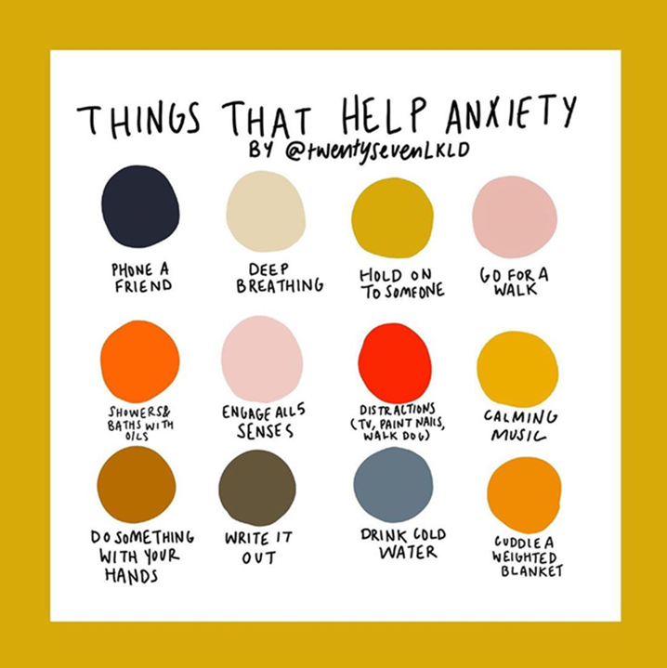
Managing anxiety
Validate their feelings
Set the tone
Help them think positively
Have a routine
Emphasise safety measures
Encourage Flexibility
Look after yourself
Be kind
Know when to get help
https://www.youngminds.org.uk/professional/spotlight-stories/my-advice-for-supporting-an-anxious-young-person/
Notes:
For a young person, how could you help manage their anxiety?
In groups write down a few or shout out
https://www.youngminds.org.uk/professional/spotlight-stories/my-advice-for-supporting-an-anxious-young-person/

Slide 15
Managing Anxiety
Despair vs Hope
Fear vs Peace
Sadness vs Joy
How can he help young people to discover hope, find peace and experience joy?
Notes:
At GF we are all Christians and we all know Jesus has the power to help us in all circumstances and anxiety is no different
Working in pairs, how might Jesus be able to help young people discover hope, find peace and experience joy?
Hope- young people can discover hope by opening up the bible and finding verses that speak on hope and read stories of hope. Peace- they can then find peace through prayer by praying for peace. Joy- then they can experience joy because they have a new perspective where they see hope and have peace and they can chose joy instead of trying to maintain the emotion of happiness (as they are two different things). God gives joy which is a constant that we can chose to walk in regardless of circumstance, whereas happiness is an emotion that comes and goes.
Hope- young people can discover hope by discovering creativity within their hobbies and what they enjoy doing. Peace- they can find peace through that because they can express themselves being content in who they are. Joy- and they can experience joy as they keep learning and increasing their skills in their hobbies to keep going and doing what they love.
Hope- young people can listen to other people’s stories of hope, maybe from what they are struggling with themselves. Peace- they can find a peace of mind through this because they realise they aren’t stuck, because someone else has come out the other side and has seen the light and living in the light at the end of their tunnel. Joy- they can then experience joy in setting small goals to success, by taking it one step at a time to make their way out of their tunnel where they can see victory. And they can experience joy in celebrating the small wins throughout that process.
Hope- young people can discover hope by looking at career options and getting involved in career workshops where they can discover their passions and talents and skills, seeing the different roads they could go down. Peace- they find peace because they can see their next steps and the achievements they need to accomplish. Joy- they experience joy because they now have a hope in their future where they see their own potential, where they can get into a routine and work towards something, not feeling stuck with no aspirations but with joy and excitement of what’s to come.
Hope- young people can discover safe people to connect with who they can trust, maybe a teacher, youth worker, a trusted adult. Peace- they can find peace in talking about their anxieties and worries and issues they face because they no longer bottle it up but can express it in a safe environment where they can process and not feel threatened. Joy- they can then experience joy in the freedom talking brings and the advice and wisdom shared by their safe person/people. They can start to work towards goals they set for themselves with the guidance of the trusted adult(s) to help them make healthy choices and give practical tips.

Slide 16

Notes:
Reflection

Slide 17
Helpful websites
https://youngminds.org.uk/find-help/conditions/anxiety/
https://www.childrenssociety.org.uk/information/young-people/well-being/resources/anxiety
https://www.kintsugihope.com/
https://www.mind.org.uk/information-support/types-of-mental-health-problems/anxiety-and-panic-attacks/about-anxiety/
https://www.anxietyuk.org.uk/

Slide 18


Slide 19

SESSION 2 - TRANQUILITY

Slide 20
What is Tranquility?
Tranquility is a six-week course to help students suffering with any type of anxiety to understand and identify their anxiety and learn to deal with it in the short, medium and long term. We will help students put strategies into place helping them to discover hope instead of despair, to find peace instead of fear and to experience joy instead of sadness.

Slide 21

How to prepare, deliver and follow up a Tranquility course
Preparation
Contact
Selection and Consent
Referrals
Pre Course Questionnaires
Time and Venue
Delivery
The Course
Staying in touch
Follow up
Post Course Evaluations
Report
Mentoring?
Notes:
Make contact with the students before hand
Make sure the right students on there for the right reasons - MAD isn’t for the ‘naughty’ students
Get referrals off your EL or safeguarding etc and make sure they are there for the right reasons
Pre course questionnaire and post course evaluation on the next slide
Reporting and mentoring, been gone through already

Slide 22

A week by week look at course materials
For the leaders:
    Aim
    Materials needed
Outline of session:
•Refresh
•Introduce
•Play
•Watch
•Discuss
•Do
•Listen
Notes:
Go onto the Toolkit showing them how to find all of this and clicking through some of the links
Questions on course before Access and Franchise

Slide 23
Franchise and Licence Agreement
The Franchisee agrees to only reproduce and use the material within Grace Foundation.
The Franchisee will not put any of the material on the internet, or Social Media platforms or send it to anyone outside of Grace Foundation.
The Franchisee will only run courses in the Grace Foundation schools. If the Franchisee wishes to add schools to their allocation this can only be done through prior arrangement with Reality Youth Project.
Only those who attend the training and are therefore licensed will lead the courses. If additional leaders need to be trained and licenced the Franchisee will inform Reality Youth Project who will discuss the training options available.

Slide 24

Notes:
Any questions?

